Slide 1

A MINI PROJECT
On
WANDERGRAM
(TRAVEL RECOMMENDATION SYSTEM)
BACHELOR OF TECHNOLOGY
IN
CSE- AI & ML
BY
K.ANIRUDH - 20VE1A6688
P.ANUSHA - 20VE1A66A6
S.SNEHA REDDY- 20VE1A66B0
S.RUTHVIK - 20VE1A66A9
(PRC-2)
Under the Guidance of
Mrs. A.SWAPNA- ASSISTANT PROFESSOR
ACADEMIC YEAR: (2020-2024)

Slide 2

CONTENTS
Abstract
Proposed System
Literature Survey
Software and Hardware Requirements
System Architecture
Modules
Dataset(s)
UML Diagrams
Modules Description
Conclusion
References
Queries

Slide 3
ABSTRACT
The Wandergram project aims to develop an innovative travel information and planning website that provides users with personalised recommendations and resources for seamless travel experiences. By leveraging advanced location-based services and interactive features, Wandergram offers an extensive collection of destination information, travel guides, points of interest, and nearby cafes, restaurants, and hangout spots.
To begin with, we're using Restricted Boltzmann machines (RBMs) to better understand and promote attractions while taking user preferences and behaviour into account. We also use distributed collaborative filtering, (K-means) for restaurant recommendations, suggest accommodations and provide a comprehensive restaurant recommendation system, respectively.
We have incorporated a chatbot that serves as a virtual travel assistant for the Wandergram project. Wandergram emerges as a pioneering companion, revolutionising the way we plan and savour our journeys and ensuring that each trip is a masterpiece of personalised exploration and discovery.

Slide 4
EXISTING SYSTEM
The existing travel information platforms often focus solely on booking services, overlooking the need for personalized recommendations. These traditional approaches lack comprehensive destination information and interactive features, limiting users' ability to explore travel options beyond booking. As a result, travelers face challenges in discovering suitable cafes, restaurants, and hangout spots during their trips, affecting their overall travel experiences. The existing system uses a decision tree algorithm.

Slide 5
DEMERITS OF EXISTING SYSTEM
Many systems base recommendations on popular choices, which might not cater to niche or unique interests.
The effectiveness of some systems depends heavily on the user's input. If a user is unsure about what they want, the recommendations might not be helpful.
Some platforms might prioritize recommendations from partners or those that offer the platform a commission.
Many systems prioritize places with high reviews. However, a place with fewer reviews might be just as good or even better.

Slide 6
PROPOSED SYSTEM
The proposed Wandergram system aims to bridge the gap in the existing travel information platforms by offering a comprehensive solution for travel planning and exploration. By integrating location-based APIs and interactive maps, Wandergram delivers personalized destination information, travel guides, and points of interest. we're implementing Restricted Boltzmann Machines (RBMs) to understand and recommend attractions more effectively, considering users' preferences and interactions. Additionally, we're applying K-Means algorithm for Collaborative Based Filtering for restaurant recommendations, in suggesting accommodations, offering a well-rounded restaurant recommendation system respectively. In the Wandergram project, we have integrated an intelligent chatbot that acts as a virtual travel assistant.

Slide 7
MERITS OF PROPOSED SYSTEM
It can save time and effort for travelers.
It excel at providing personalized recommendations based on individual preferences and constraints.
It uses leverage vast amounts of data from various sources such as travel websites, reviews, etc. .
It provides the ability to provide real-time updates to travelers during their trips.
It can seamlessly integrate multiple modes of transportation, such as flights, trains

Slide 8
LITERATURE SURVEY
1. Paper Title: "Personalized Attraction Recommendation System for Tourists Through Check-In Data" (2021)*
Authors: K. Kesorn, W. Juraphanthong, and A. Salaiwarakul
Description: In this study, the authors developed a personalized attraction recommendation system for tourists based on check-in data.
Results Obtained: The obtained results demonstrate a remarkable accuracy rate of 86%, showcasing the potential of personalized attraction recommendations in the tourism industry.
2. Paper title : Personalized one-day travel with multi-nearby-landmark recommendation,2021
Authors: Siya Bao, Masao Yanagisawa,Nozomu Togawa
Description of proposed algorithm : This paper proposes a personalized travel recommendation algorithm with time planning. We use landmark categorization and region clustering to obtain effective elements. Then we build a travel map to generate all possible travel routes
Results Obtained: 70 % of accuracy

Slide 9
LITERATURE SURVEY
3.Paper title : Agent-based personalised recommendation of touristic activities,2020
Authors : Batet, M., Moreno, A., Sánchez, D., Isern, D.
Description of proposed algorithm :This paper presents "Turist@," an agent-based personalized recommendation system for touristic activities.
Results Obtained : 79 % of accuracy
4.Paper Title: "A Survey of Travel Recommender System" (2020)*
Authors: Roopesh L and Tulasi
Description: This survey paper provides an in-depth overview of travel recommender systems.
Results Obtained: The survey does not present specific accuracy values but provides a foundational understanding of the landscape of travel recommendations

Slide 10
LITERATURE SURVEY
5.Paper title: Normalized Attraction Travel Personality Representation for Improving Travel Recommender Systems ,2020
Authors : Turki Alenezi, Stephen Hirtle
Description of proposed algorithm: It proposes a method derived from topic-model-based models to represent travel attractions, called the Normalized Attraction Travel Personality (NATP) representation.
Results Obtained by the author:73 % of accuracy
6. Paper title: Travel Recommendation System Using Content and Collaborative Filtering - A Hybrid Approach,2019
Authors: Vyshnavi Garipelly,Padma Teja Adusumalli,Priyanka Singh
Description of proposed algorithm: This paper focuses on developing a personalized attraction recommendation system using content based and collaborative based filtering,It aims to enhance tourists experiences by suggesting attractions tailored to their preferences and check-in history.
Results Obtained by the author: 76% of accuracy

Slide 11
LITERATURE SURVEY
7. Paper title: Efficient User Profiling Based Intelligent Travel Recommender System for Individual and Group of Users(2019)
Authors: V. Vijayakumar & Xiong Li
Description of proposed algorithm:This paper focuses on developing a personalized attraction recommendation system for tourists based on check-in data.
Results Obtained by the author:69 % of accuracy
8. Paper title:A Comprehensive Survey on Travel Recommender Systems(2019)
Authors: Kinjal Chaudhari, Ankit Thakkar
Description of proposed algorithm:In this survey, we have presented a pervasive review on travel and associated factors such as hotels, restaurants, tourism package and planning, and attractions; we have also tailored recommendations on a tourist’s diverse requirements such as food, transportation, photography, outfits, safety, and seasonal preferences.
Results Obtained by the author:60 % of accuracy

Slide 12
LITERATURE SURVEY
9. Paper Title:"A Collaborative Location Based Travel Recommendation System through Enhanced Rating Prediction for the Group of Users"(2016)
Authors: Logesh Ravi and Subramaniyaswamy Vairavasundaram
Description: proposes a collaborative location-based travel recommendation system that enhances the accuracy of rating predictions for groups of users.
Results Obtained:The obtained results demonstrate a remarkable accuracy rate of 66%,
10. Paper Title: ”Personalized Travel Recommender Model Based on Content-based Prediction and Collaborative Recommendation”(2016)
Authors: Shini Renjith , Anjali CA
Description: proposes a personalized travel recommender model that combines content-based prediction and collaborative recommendation techniques.
Results Obtained:The obtained results demonstrate a remarkable accuracy rate of 76%,

Slide 13
SOFTWARE REQUIREMENTS
The software requirements, also known as general description papers, also include information about the product's perspective and features, operating system and operating environment, graphic needs, design constraints, and user documentation. These requirements show us the necessary software functionalities and performance criteria that need to be met to ensure the successful completion of the project.
Technology: Python, Machine Learning, NLP
Frontend: Html,CSS,JS
Backend: Flask

Slide 14
HARDWARE REQUIREMENTS
The minimum hardware requirements necessitate a modern and capable computer system to handle the computational demands of ML algorithms and data processing effectively. The hardware requirements include a processor that can efficiently execute computations, an ample amount of RAM to store and manipulate large datasets during training and inference, sufficient storage space to accommodate datasets, ML models, and related files
Operating system: Windows, IOS
Processor: Intel i5 or equivalent for smooth application performance.
RAM:R 8GB RAM or higher for efficient data processing.
Internet Connection: High-speed internet connectivity for seamless API interactions.

Slide 15
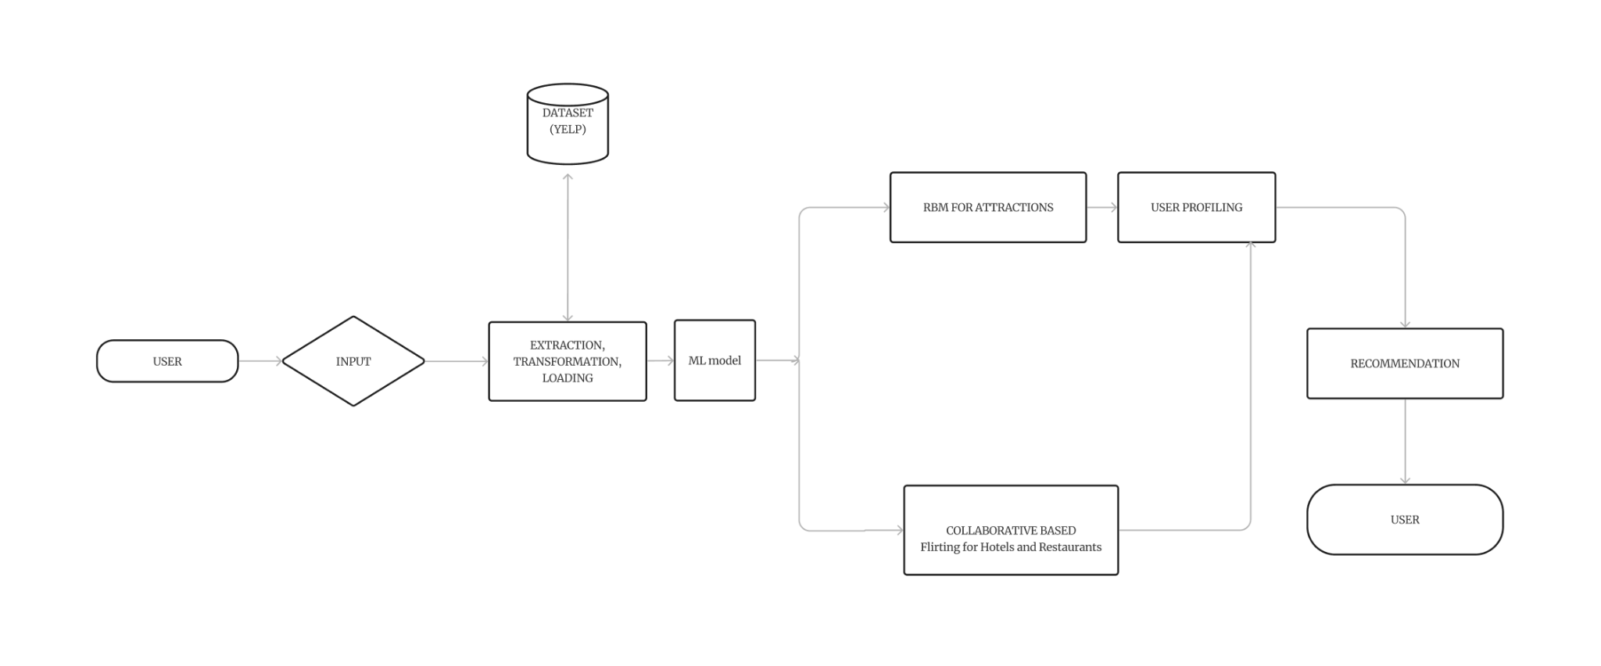
SYSTEM ARCHITECTURE

Slide 16
SYSTEM ARCHITECTURE
User Input: Users provide input by interacting with the Wandergram application. This input can include their travel preferences, destination choices, and any specific requests or criteria they have for their trip.
Data Extraction and Transformation: Data is extracted from various sources, such as APIs, databases, and web scraping. This data includes information about destinations, attractions, restaurants, accommodations, and user interactions. Before using this data, it's transformed and prepared for analysis.
Machine Learning Models: The system utilizes machine learning models to make personalized recommendations. This includes the following components:
a. RBMs for Attractions:
RBMs are used to analyze user preferences and interactions with attractions. This model helps identify patterns and similarities among users and attractions.

Slide 17
SYSTEM ARCHITECTURE
b. Collaborative Filtering for Restaurants:
This Collaborative Filtering for Restaurants combines various algorithms (e.g., K-Means, collaborative filtering) to suggest restaurants based on user preferences and interactions.
User Profiling: User profiling involves creating a profile for each user based on their past interactions, preferences, and behavior. This profile is used to better understand what the user is looking for and to make personalized recommendations.
Recommendation Generation: Using the RBMs, hybrid recommendation system, and user profiling, the system generates personalized recommendations for attractions, restaurants, accommodations, and other points of interest. These recommendations are tailored to each user's preferences and are designed to enhance their travel experience.
Final Recommendations to User:The system refines its recommendations and presents the final set of recommendations to the user, helping them plan their trip effectively.

Slide 18
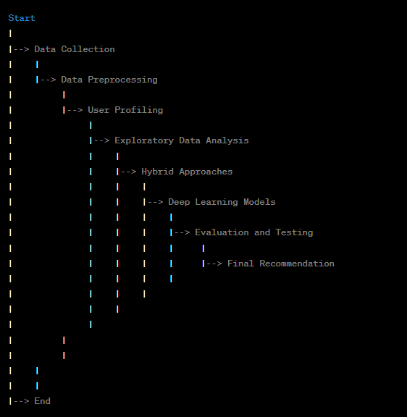
MODULES
Data Collection
Data Preprocessing
User Profiling
Exploratory Data Analysis
K-Means Approach
Deep learning models
Evaluation and Testing
Final Recommendation

Slide 19
MODULES
Data Collection: The data collection phase involves in gathering data from various sources, including user reviews, travel websites, and other relevant sources. This data can include information about destinations, hotels, restaurants, activities, and more.
Data Preprocessing: The data preprocessing phase involves cleaning and preprocess the collected data to ensure it's consistent and ready for analysis. This may involve tasks like data normalization, handling missing values, and text processing (e.g., sentiment analysis of user reviews.
User Profiling: The user profiling phase involves in creating user profiles based on their preferences, past travel history, and demographic information. This step helps the system understand individual users better.
Exploratory Data Analysis: The Exploratory Data Analysis involves in analyzing user data, patterns regarding popular destinations, travel habits, and preferences can be identified. This understanding helps in creating more personalized travel suggestions.

Slide 20
MODULES
K-means Approach: A k-means approach phase involves in collaborative filtering method which is used to improve recommendation accuracy and give accurate results
Deep learning models: The deep learning model we used is restricted boltzmann technique which is a neural network model , used to provide efficient way to capture latent features from large datasets, making them suitable for travel recommendation systems because of their ability to learn unique patterns in user-prefered interactions.
Evaluation and Testing: The Evaluation and Testing phase involves in Evaluating the performance of the recommendation system using metrics such as accuracy, precision, recall, and user engagement.
Final Recommendation: The final recommendation phase involves presenting personalized travel options to users based on their profiles and preferences, enabling them to make informed choices for their trips.

Slide 21
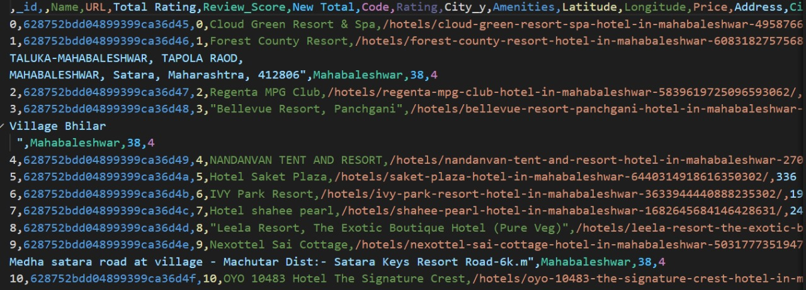
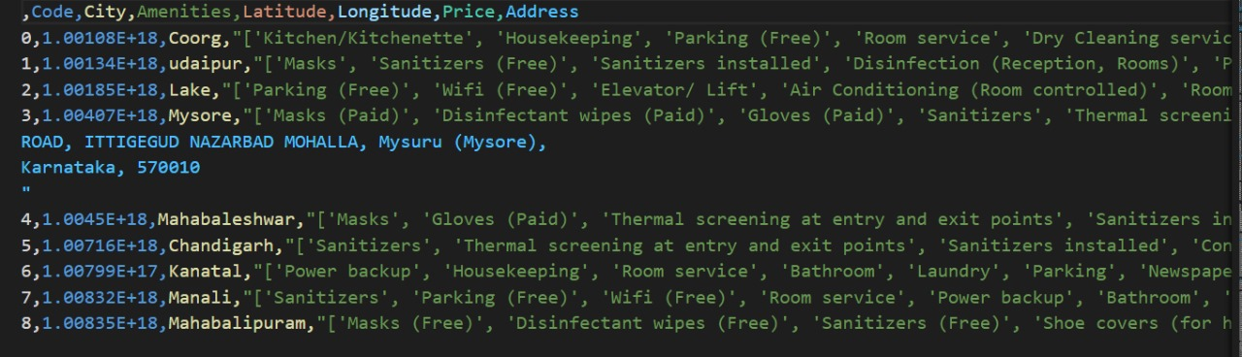
DATASET(S)
The proposed system is trained on below Datasets..
Dataset: The india tourism dataset:
Available at: kaggle (Public dataset)
Number of samples:10,172
The proposed system is tested on Below Datasets..
Dataset: Recommender system for travel packages
Available at: Kaggle (Public dataset)
Number of samples: 9,234

Slide 22
UML DIAGRAMS
Unified Modeling Language (UML) diagrams are a standard way to visually represent the design of a system. UML diagrams can be used to model the static structure of a system, the dynamic behavior of a system, and the interactions between different parts of a system.
It is a prominent visual modeling language used to create, visualize, specify, and record the behavior and structure of software systems and other systems.
Software engineers, system architects, and designers can develop visual models of systems with the help of a set of graphical notations provided by UML.
The main method for illustrating various system components is using UML diagrams. The visual model provided by UML enables stakeholders to clearly and concisely discuss, assess, and comprehend different system components.

Slide 23
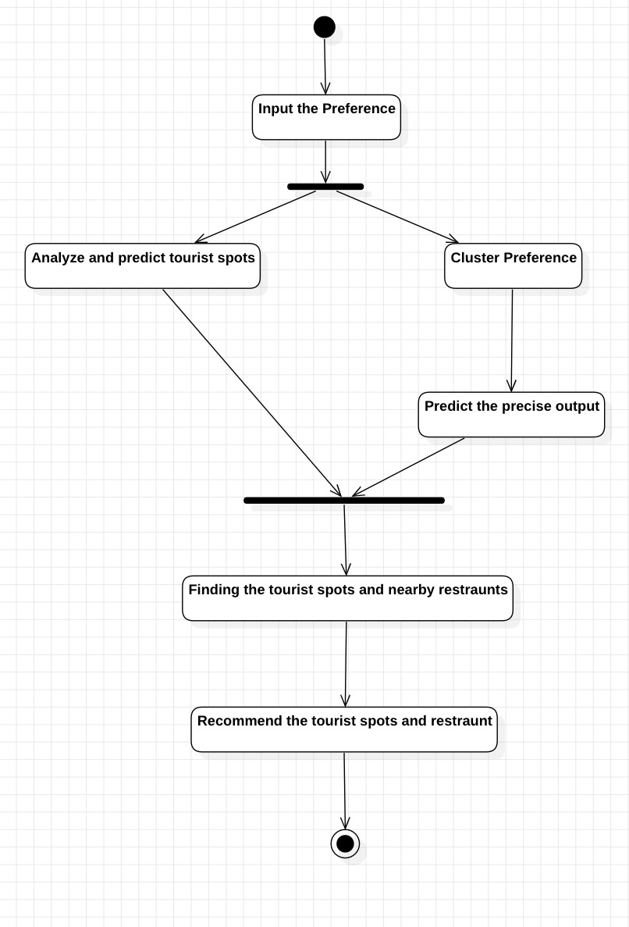
ACTIVITY DIAGRAM
An activity diagram is a type of UML diagram that shows the flow of activities in a system.
The user enters their travel preferences (e.g., destination, dates, budget, and interests).
The system uses NLP to understand the user's input
The system uses k-means clustering to group similar travel destinations together.
The system uses RBM to generate personalized travel recommendations for the user, based on their preferences and the k-means clusters.
The system presents the travel recommendations to the user.
The user can filter the travel recommendations based on their preferences.

Slide 24
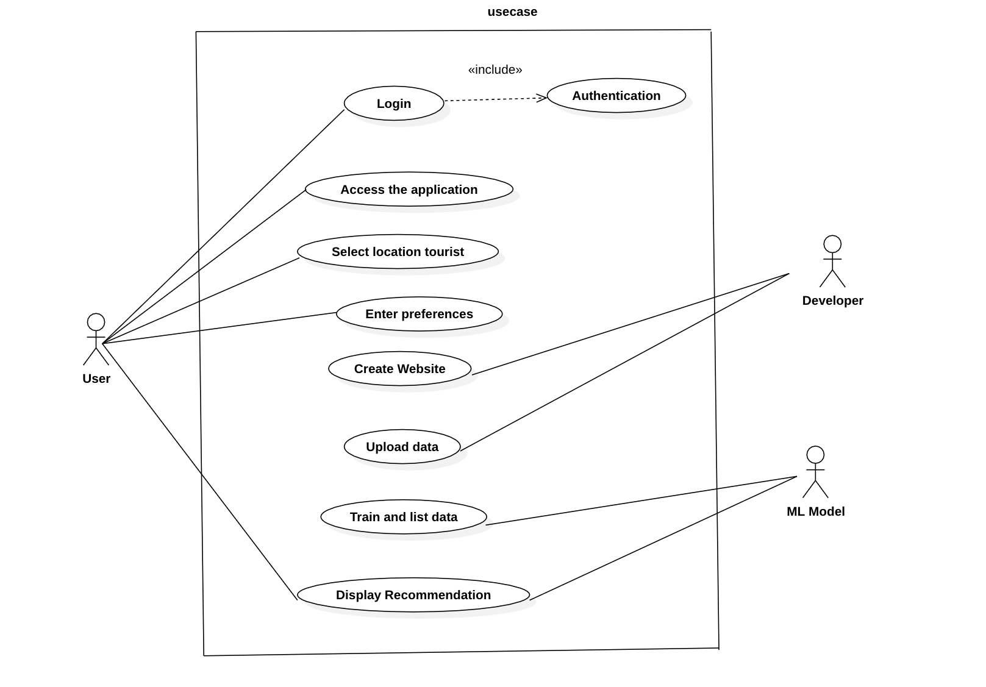
USE CASE DIAGRAM
A use case diagram is a type of UML diagram that shows the interactions between a system and its users.It is used to model the functional requirements of a system.
Actors:
User: The user of the travel recommendation system.
System: The travel recommendation system itself.
Use Cases:
Search for travel recommendations: The user enters their travel preferences, such as budget, destination type, and activities, and the system generates a list of recommended destinations and itineraries.
View travel recommendations: The user can view the recommended destinations and itineraries in more detail, including information on flights, hotels, and activities.

Slide 25
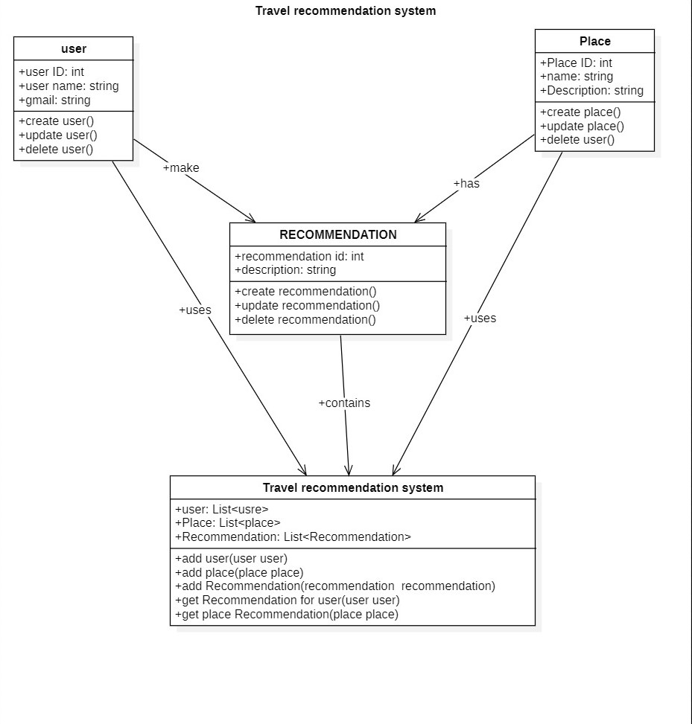
CLASS DIAGRAM
Class diagrams can be used to identify the different classes in a system and their relationships to each other. Class diagrams can be used to design the object-oriented model of a system.
Classes:
User: This class represents a user of the travel recommendation system.
Destination: This class represents a travel destination.
Recommendation: This class creates a recommendation.
Travel Recommendation System: This class represents a recommendation.
Attributes:
User: name, email, travel preferences
Destination: name, location, activities
Recommendation: hotels, activities
Travel Recommendation System: destination, itinerary, score

Slide 26
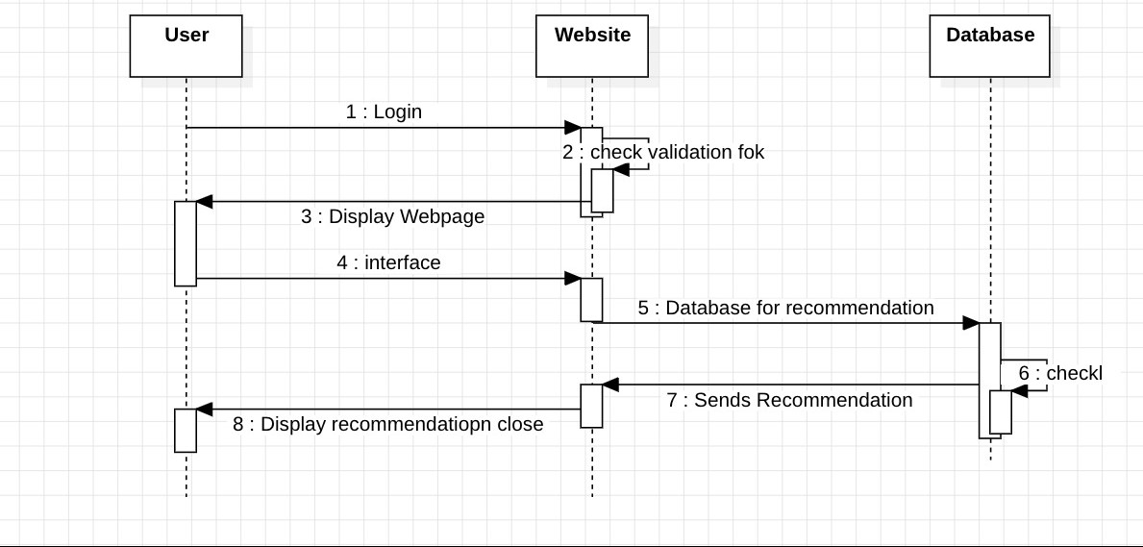
SEQUENCE DIAGRAM
A sequence diagram is a type of Unified Modeling Language (UML) diagram used to visualize the interactions and flow of messages between different components or objects in a system.
(USER LAYER)
The user enters their travel preferences into the user interface.
The travel recommendation engine receives the user's travel preferences from the user interface.
The travel recommendation engine checks the database for recommendation
The travel recommendation engine sends the travel recommendations to the user interface.
The user interface displays the travel recommendations to the user.

Slide 27
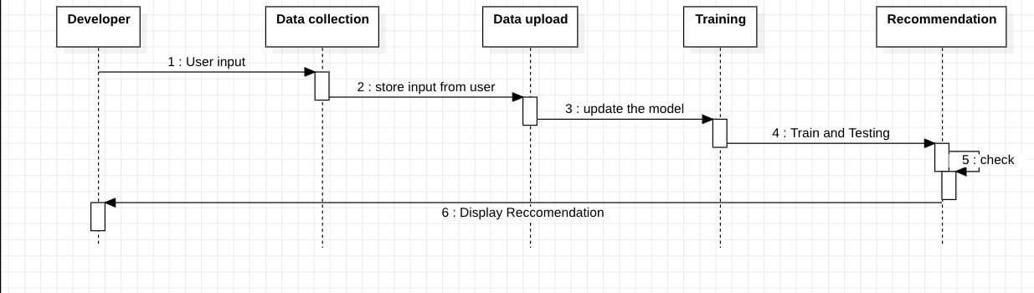
SEQUENCE DIAGRAM
(DEVELOPER LAYER)
The travel recommendation engine receives the user's travel preferences from the user interface.
The travel recommendation engine uses the k-means clustering component to group similar travel destinations together.
The travel recommendation engine uses the RBM component to generate personalized travel recommendations for the user, based on their preferences and the k-means clusters.
The travel recommendation engine uses the NLP component to understand the user's feedback on the travel recommendations and improve them over time.
The travel recommendation engine sends the travel recommendations to the user interface.
The user interface displays the travel recommendations to the user.

Slide 28
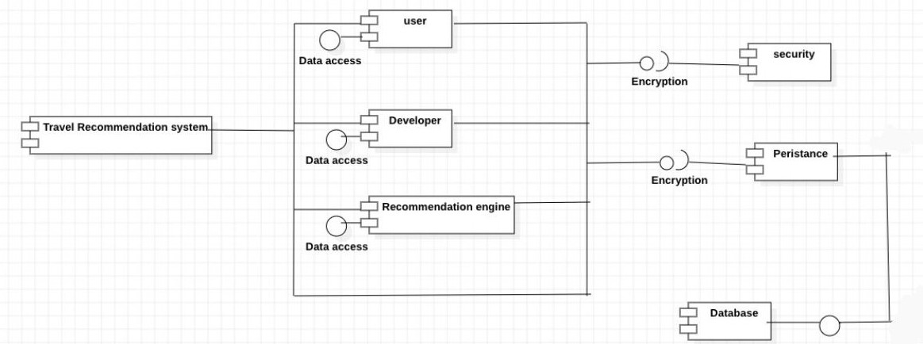
COMPONENT DIAGRAM
Component diagrams can be used to identify the different components that make up a system. Component diagrams can be used to understand the dependencies between components.
Components:
User: It is responsible for providing the user with an interface to interact with the system and providing the information about the user's travel preferences.
Developer: It is responsible for developing and maintaining the system, including the recommendation engine.
Recommendation Engine: It is responsible for generating personalized recommendations for users based on their travel preferences.
Dependencies:
The User component depends on the Recommendation Engine to generate personalized recommendations.
The Developer component depends on the User component to get feedback on the system and to identify new features and updates.
The Recommendation Engine component depends on the Developer component to maintain the system and to provide new features and updates.

Slide 29
MODULES DESCRIPTION
In the design and development of a sophisticated travel recommendation system, several key modules are integrated to provide users with personalized and engaging travel suggestions. These modules work in tandem to process user inputs, organize destination data, and fine-tune recommendations. The modules we used in the system are:
Data Collection
Data Preprocessing
User Profiling
Exploratory Data Analysis
K-Means Approach
Deep learning models
Evaluation and Testing
Final Recommendation
Let's delve into the specific functionalities and roles of each module to better understand their contributions to the system.

Slide 30
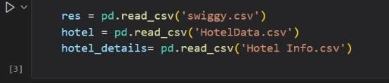
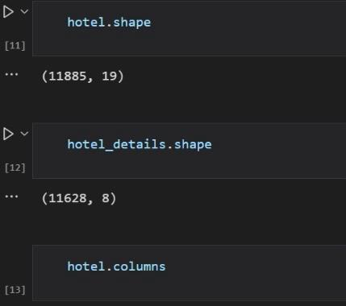
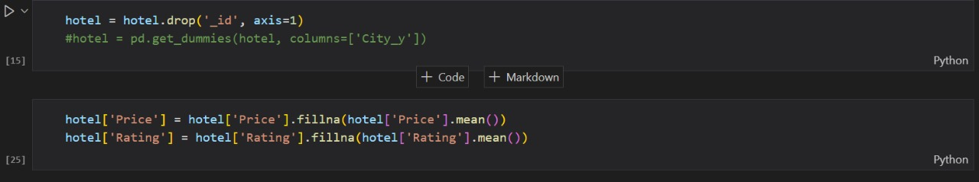
Data Collection
2. Data Preprocessing

Slide 31
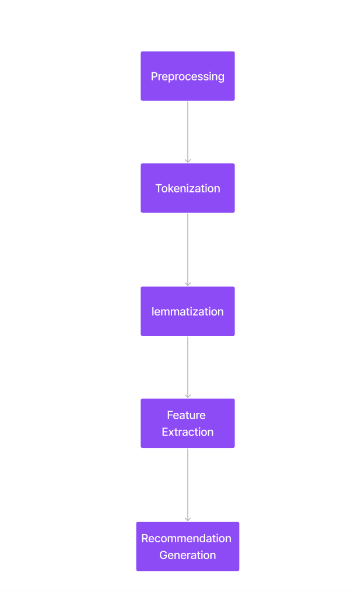
MODULES DESCRIPTION
The NLP (Natural Language Processing) Module- Data preprocessing
The NLP module of a travel recommendation system is responsible for extracting information from user reviews and other travel content, such as blog posts, articles, and social media posts. This information can then be used to better understand the user's preferences and to generate more personalized recommendations.
The NLP module typically works in the following steps:
Preprocessing: The NLP module first preprocesses the text by removing punctuation, special characters, and stop words.
Tokenization: The NLP module then tokenizes the text by splitting it into individual words or phrases.
Lemmatization: Lemmatization in travel recommendation systems helps identify the root words of user preferences and travel experiences, which can be used to generate more personalized recommendations.
Feature extraction: The NLP module then extracts features from the text. These features can be anything relevant to the travel domain, such as the user's travel interests, budget, and destination preferences.
Recommendation generation: The NLP module can then use the extracted features results to generate personalized recommendations for the user.

Slide 32
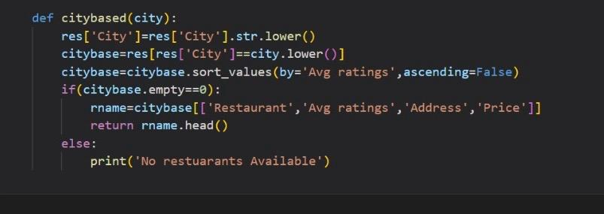
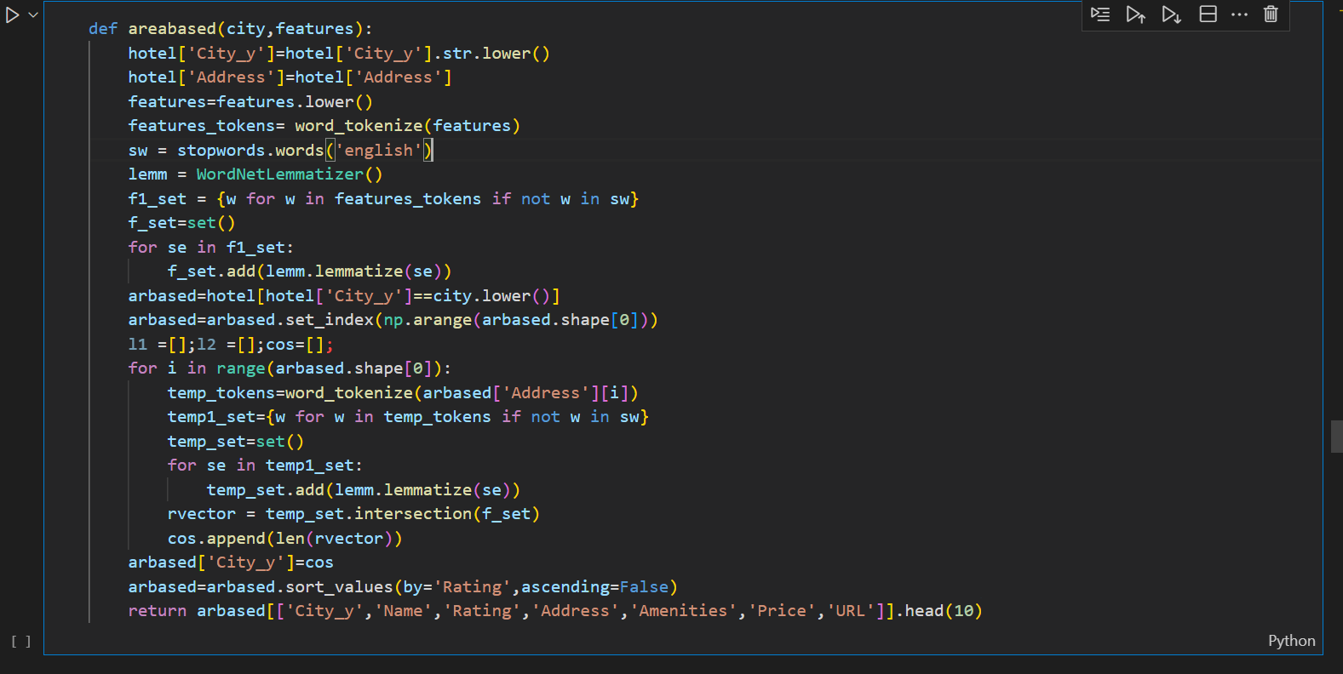
3. User Profiling

Slide 33
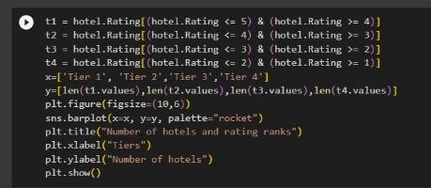
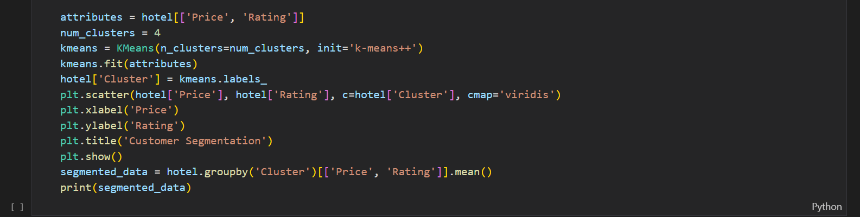
4. Exploratory Data Analysis
5. K-Means Approach

Slide 34
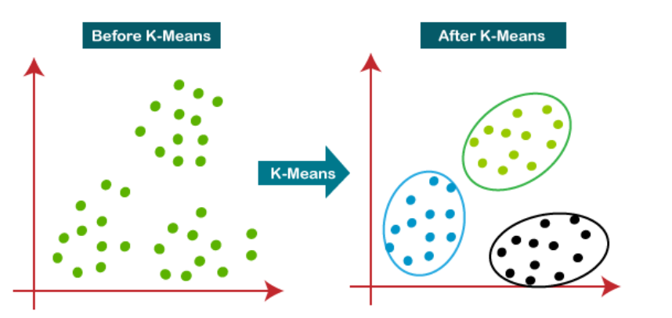
MODULES DESCRIPTION
The K-means Clustering Module
K-Means Clustering is an unsupervised learning algorithm that is used to solve the clustering problems in machine learning or data science. It is an iterative algorithm that divides the unlabeled dataset into k different clusters in such a way that each dataset belongs only one group that has similar properties.
The working of the K-Means algorithm is explained in the below steps:
Step-1: Select the number K to decide the number of clusters.
Step-2: Select random K points or centroids. (It can be other from the input dataset).
Step-3: Assign each data point to their closest centroid, which will form the predefined K clusters.
Step-4: Calculate the variance and place a new centroid of each cluster.
Step-5: Repeat the third steps, which means reassign each datapoint to the new closest centroid of each cluster.
Step-6: If any reassignment occurs, then go to step-4 else go to FINISH.
Step-7: The model is ready.

Slide 35
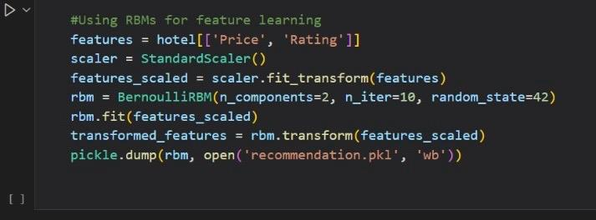
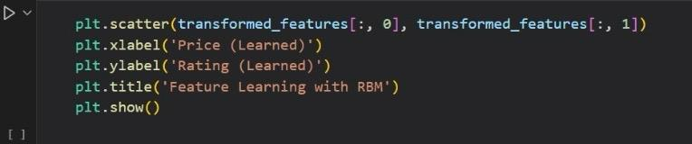
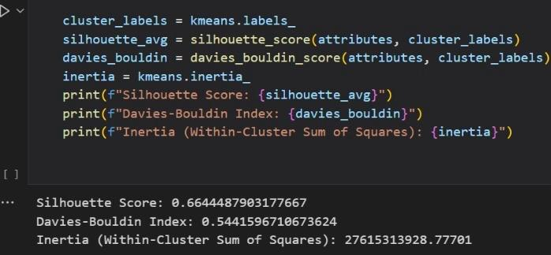
6. Deep learning models- RBM
7. Evaluation and Testing

Slide 36
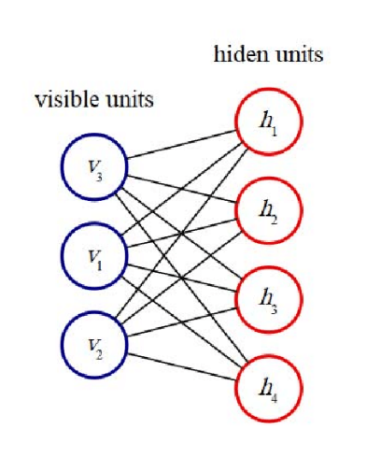
MODULES DESCRIPTION
RBM (Restricted Boltzmann Machine) Module.
RBMs are a type of artificial neural network that is used for unsupervised learning. They are a type of generative model that is capable of learning a probability distribution over a set of input data. RBMs have two layers: a visible layer and a hidden layer. The visible layer represents the input data, while the hidden layer represents a set of features that are learned by the network.
RBMs work in two phases:
Feed forward pass: In this phase, the RBM takes the input data and uses the weights and biases between the visible and hidden layers to activate the hidden layer. This process identifies the positive and negative associations between the visible and hidden units.
Feed backward pass: Since RBMs do not have an output layer, they reconstruct the input data using the activated hidden units. This process is called backtracking. The error between the reconstructed input and the actual input is then used to adjust the weights between the visible and hidden layers.
After these two phases are complete, the RBM has learned a pattern that is responsible for activating the hidden neurons. This pattern can then be used to generate new data or to recommend items to users.

Slide 37
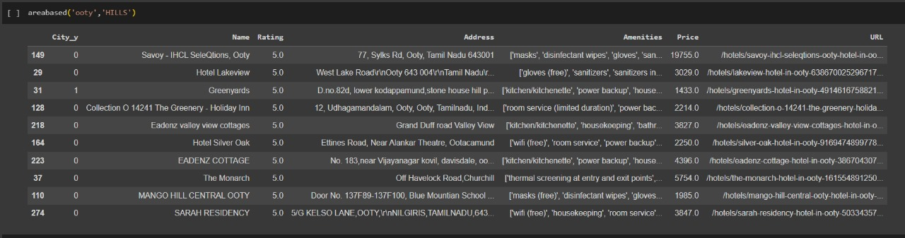
8. Final Recommendation

Slide 38
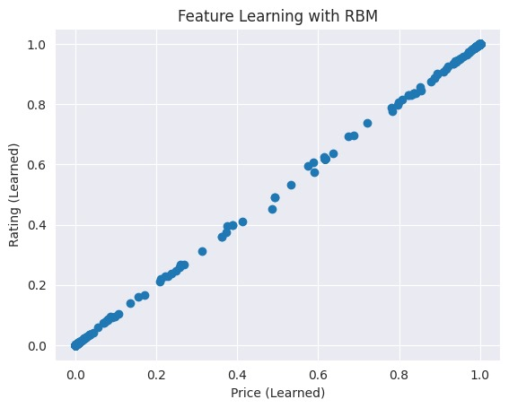
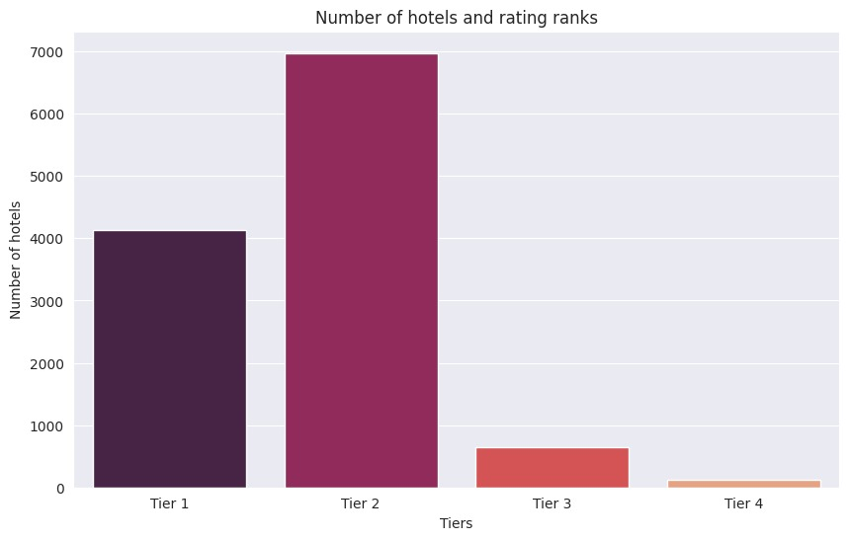
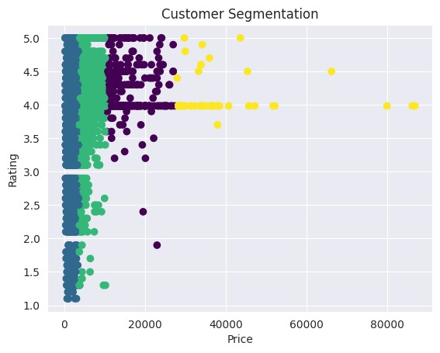
RESULTS
RBM RESULTS
K-MEANS RESULTS
COSINE SIMILARITY

Slide 39
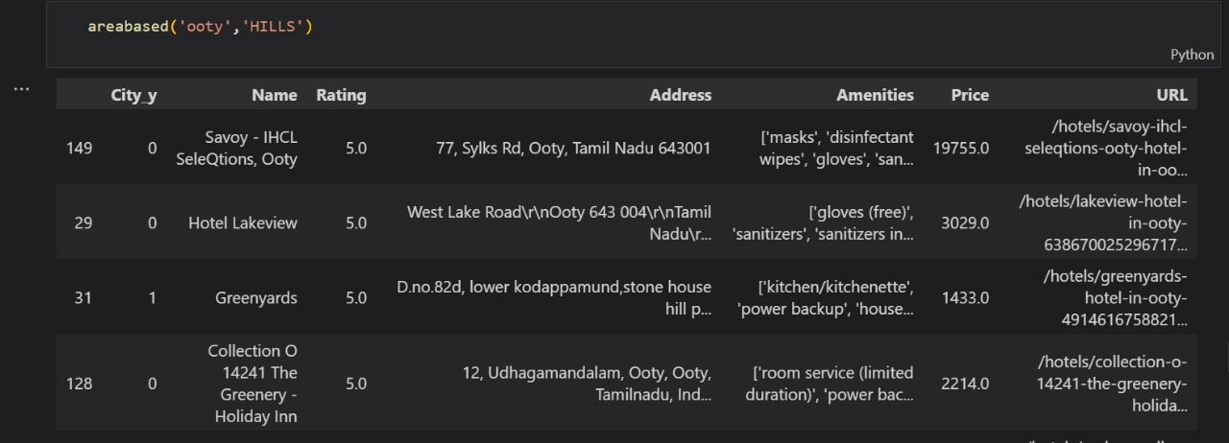
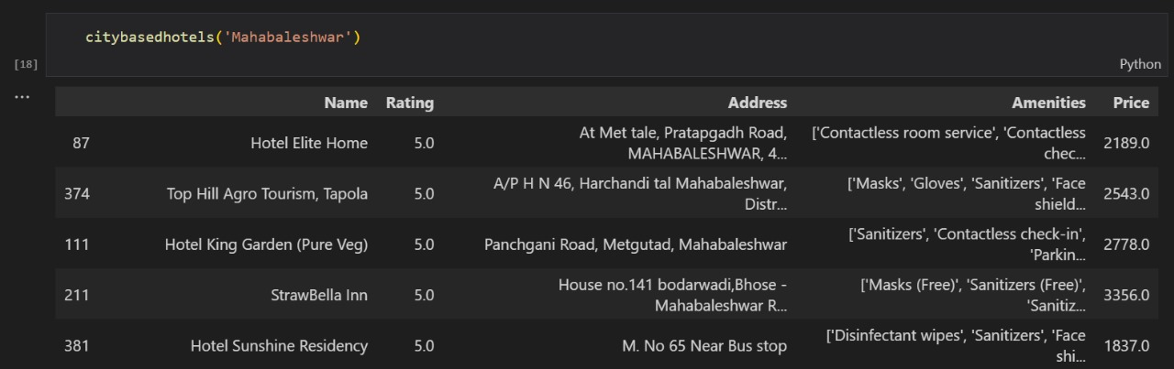
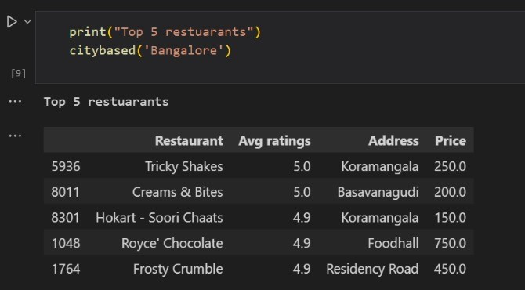
OUTPUT

Slide 40
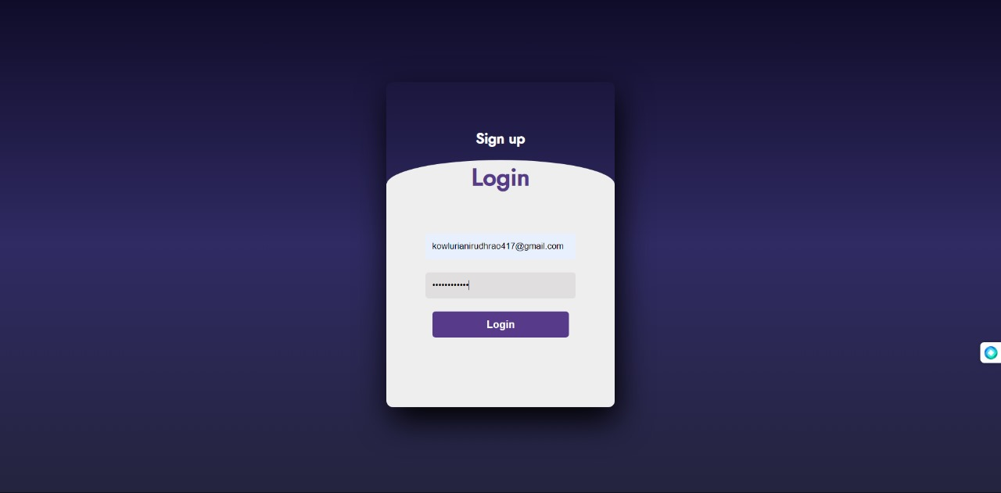
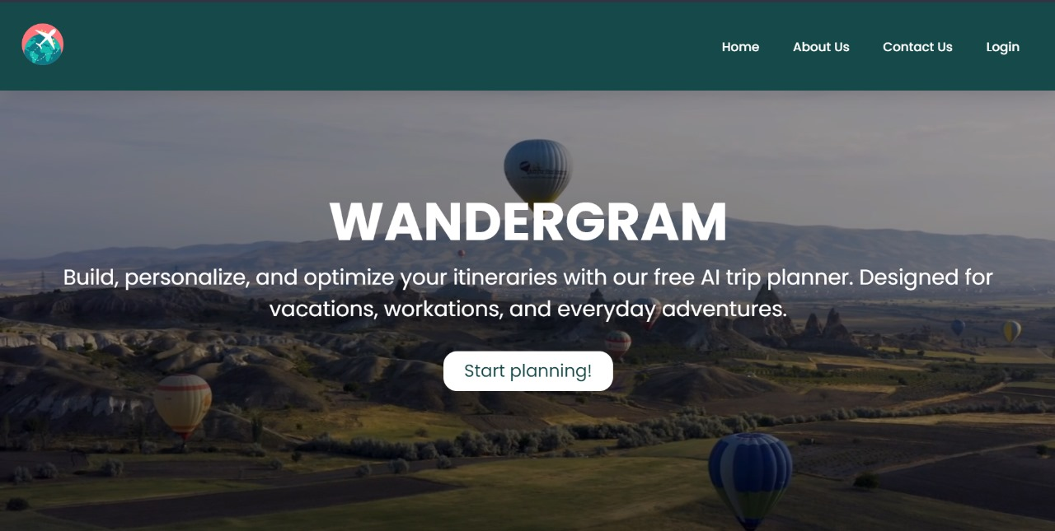
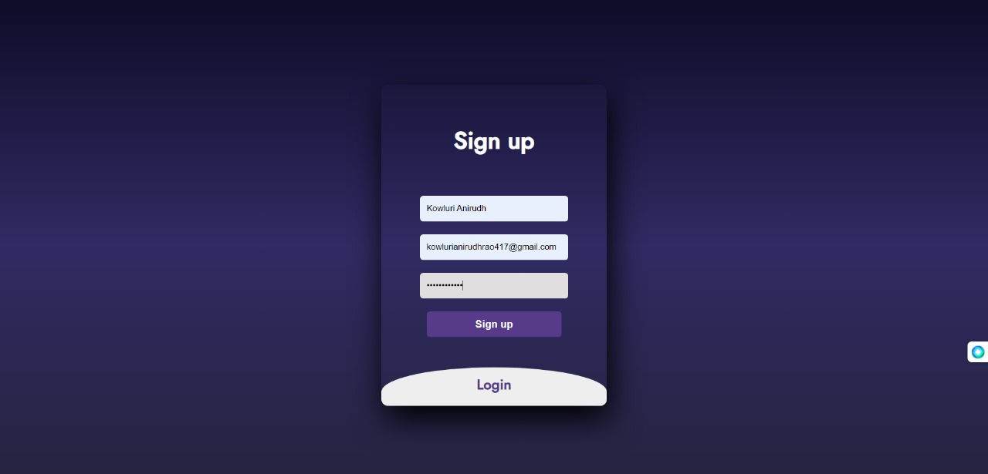
OUTPUT

Slide 41
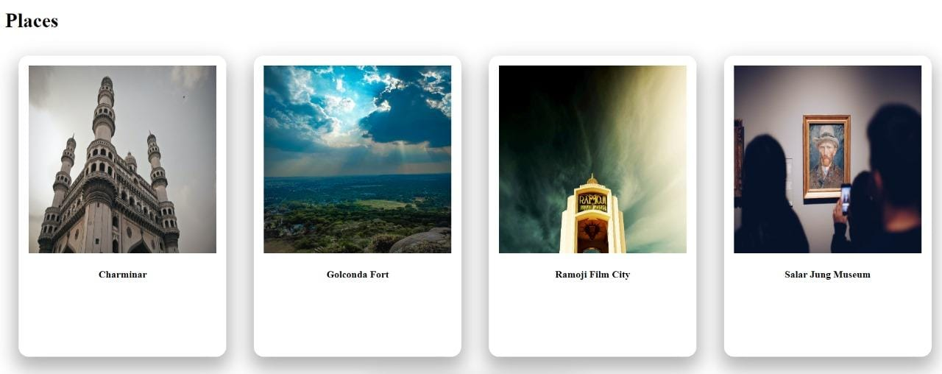
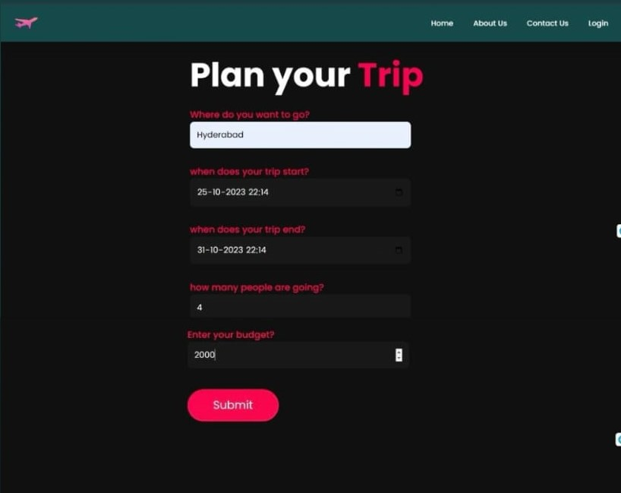
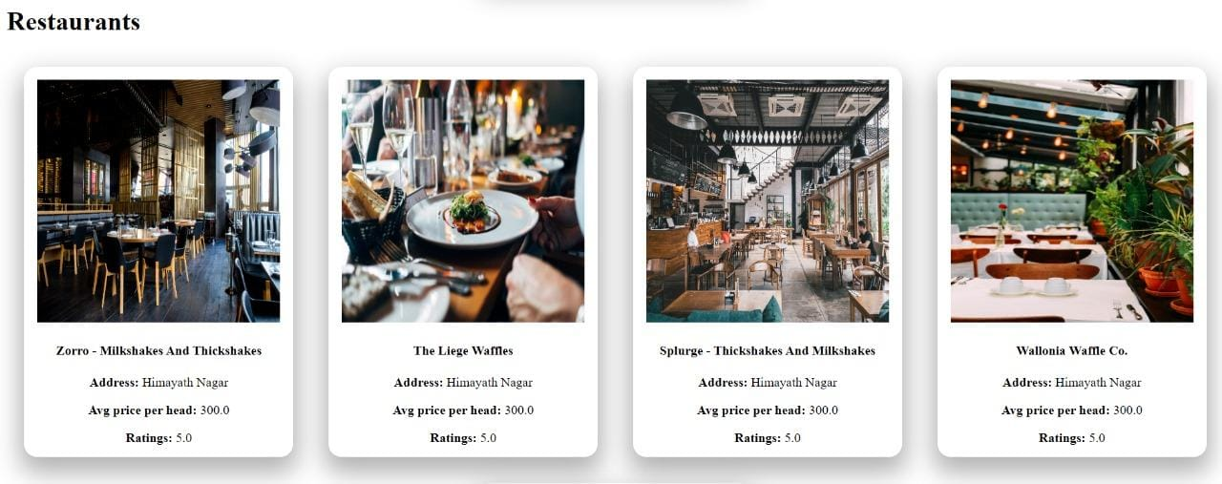
OUTPUT

Slide 42
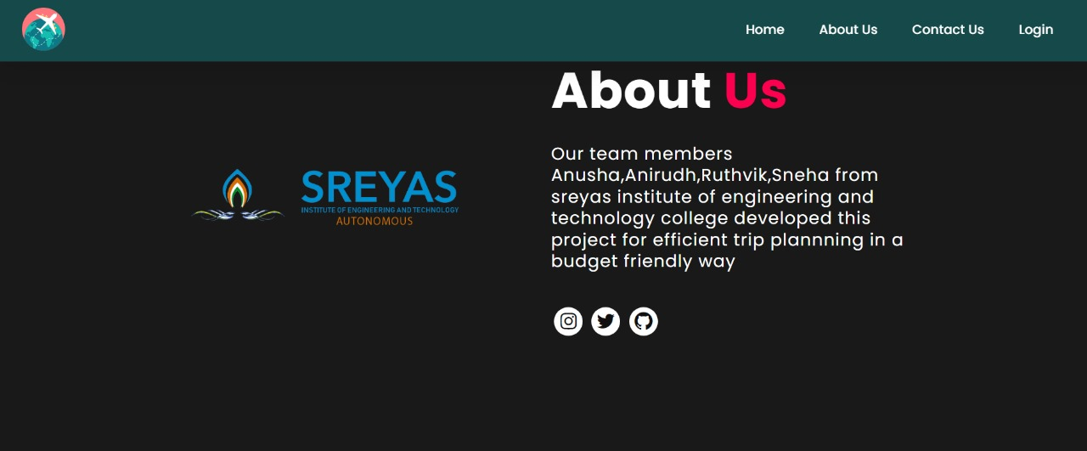
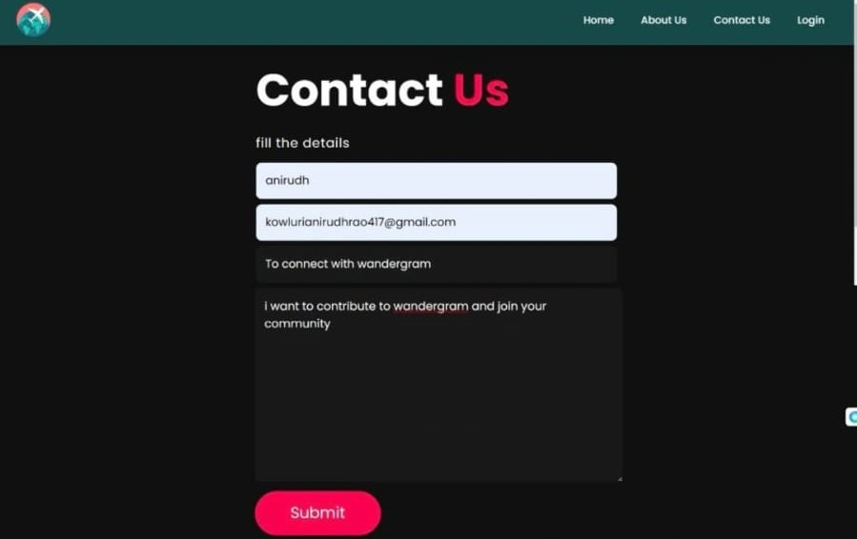

Slide 43
CONCLUSION
In conclusion, the Wandergram project is an innovative travel information and planning website that redefines the way we explore the world. Leveraging advanced technologies like Restricted Boltzmann Machines (RBMs), Distributed Collaborative Filtering, K-Means . Wandergram offers personalized recommendations for attractions, restaurants, accommodations, and more.This platform goes beyond conventional travel resources by providing interactive maps, location-based services, and an intelligent chatbot, serving as a virtual travel assistant. Wandergram's user-friendly interface and intuitive search options make it easy for travelers to access destination information, plan itineraries, and discover local gems. Travelers can explore their destinations efficiently, whether they're seasoned adventurers or first-time explorers. Wandergram is not just a website; it's a transformative companion that ensures each trip is a masterpiece of personalized exploration and discovery.

Slide 44
REFERENCES
Logesh Ravi, Subramaniyaswamy Vairavasundaram, "A Collaborative Location Based Travel Recommendation System through Enhanced Rating Prediction for the Group of Users", Computational Intelligence and Neuroscience, vol. 2016, Article ID 1291358, 28 pages, 2016.
Shini Renjith , Anjali CA ,”Personalized Travel Recommender Model Based on Content-based Prediction and Collaborative Recommendation”International Journal of Computer Science and Mobile Computing, ICMIC 13, December- 2016, pg. 66-73
Personalized Attraction Recommendation System for Tourists Through Check-In Data “K. KESORN , W. JURAPHANTHONG, AND A. SALAIWARAKUL
Roopesh L , Tulasi,”A Survey of Travel Recommender System” Vol.-6, Issue-9, Sep 2018 E-ISSN: 2347-2693
Batet, M., Moreno, A., Sánchez, D., Isern, D., Valls, A.: Turist@: Agent-based personalised recommendation of touristic activities. Expert Syst. Appl. 39, 7319–7329 (2016)

Slide 45
REFERENCES
A Personalized Travel Recommendation System Using Social Media Analysis Joseph Coelho;Paromita Nitu;Praveen Madiraju 2018 IEEE International Congress
Personalized and relational approach for travel package recommendation Komal Popat;Tejaswini Thorat;Manisha Vidhate;Neha Rane;NamrataD Ghuse 2016 International Conference on Green Computing and Internet of Things (ICGCIoT) Publisher: IEEE
A user-location vector based approach for personalised tourism and travel recommendation D. Ajantha;Jobi Vijay;Raji Sridhar 2017 International Conference on Big Data Analytics and Computational Intelligence (ICBDAC) Publisher: IEEE
A Travel Recommendation Method Based on User Personalized Characteristics with Collaborative Fusion Matrix,Xian Chen;Lang Luo;Zejun Hu;Xingjian Pei;Qianqian Peng;Mengyuan Han;Lijie Wei;Hyoseop Shin 2020 5th International Conference on Mechanical, Control and Computer Engineering (ICMCCE) | Publisher: IEEE
PersonalTour: A Recommender System for Travel Packages Fabiana Lorenzi;Stanley Loh;Mara Abel 2016 IEEE/WIC/ACM International Conferences on Web Intelligence and Intelligent Agent Technology,Publisher: IEEE

Slide 46
QUERIES?

